Slide 1



Arduino 4 – motor
Steven hammer
s.hammer@hw.ac.uk

Slide 2
introduction
Use an Arduino with PWM to control a motor
Use a potentiometer to adjust the speed of the motor

Slide 3
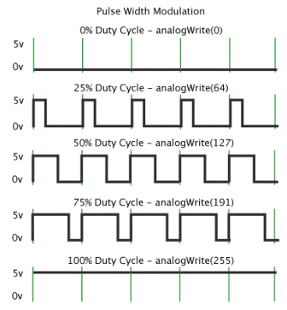
What is pwm?
PWM = Pulse Width Modulation
Switch on/off at varying frequencies to control motor speed

Slide 4
What are we doing today?
Turn the motor on and off
Slowly accelerate the motor from zero to full speed then back to zero
Use a potentiometer to control the speed of the motor

Slide 5
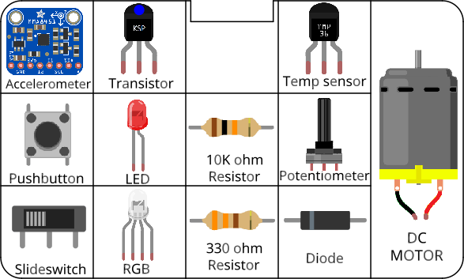
Circuits
All components included in the kit…

Slide 6
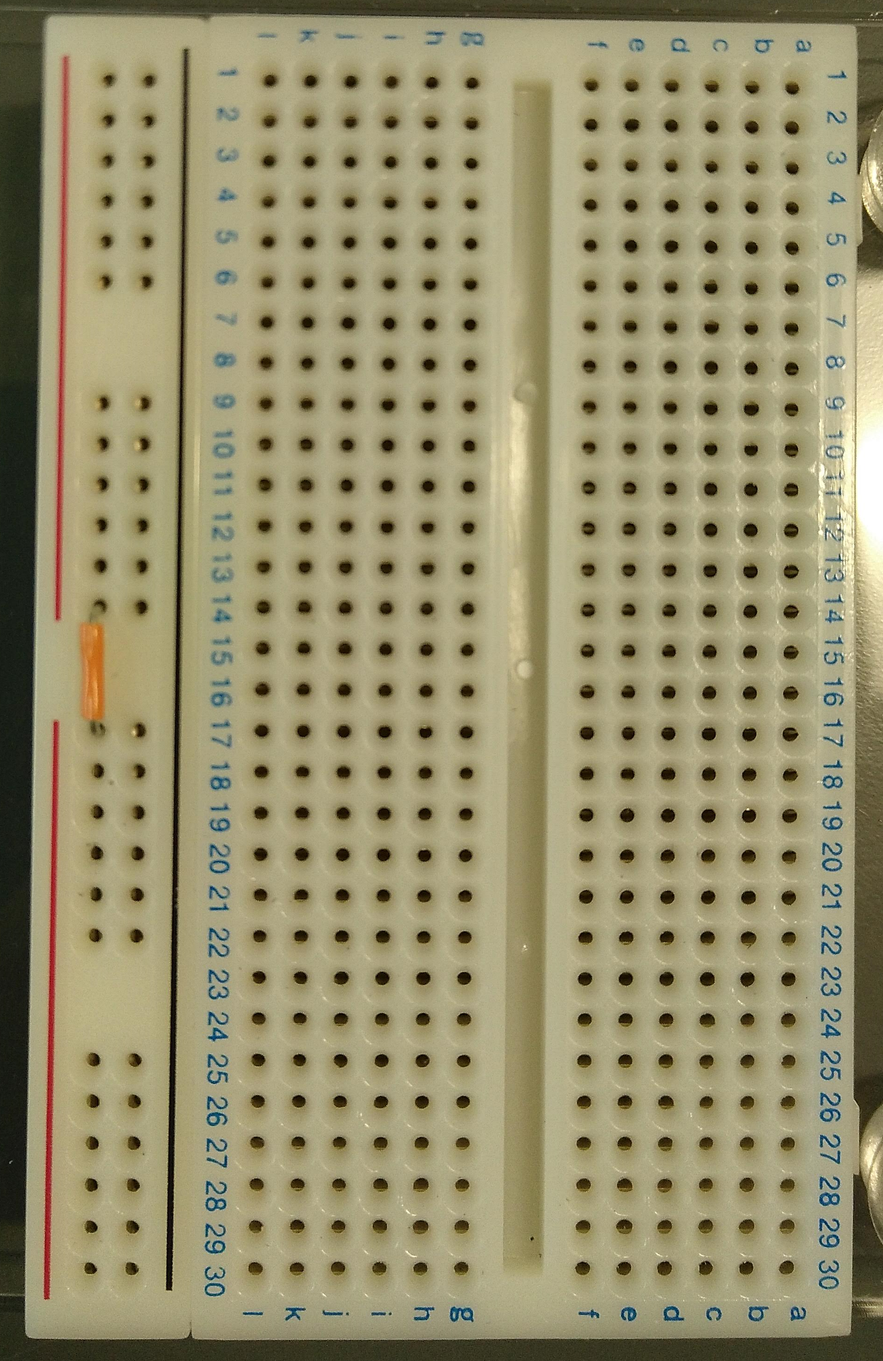
Before you start Building circuits…
Connect power bus (+ line) together using a small section of jumper cable

Slide 7
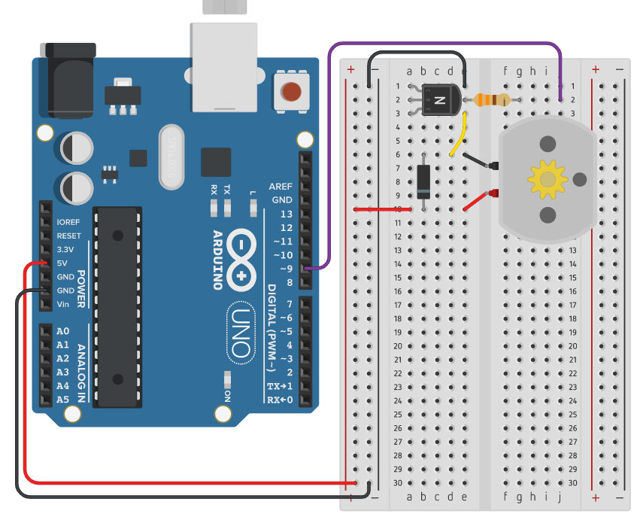
Building circuits
Insert components into breadboard holes
Connect up using instrument wire
Arduino controls inputs and outputs
Follow schematics
NOTE: GND = negative

Slide 8
Debugging code
Is there a space missing somewhere?
Do all lines end with a semicolon;
Is something commented out //

Slide 9
housekeeping
Take two boxes:
One Arduino box
One Sensors and Motion kit
Put components back into labelled places in boxes after use
Any components missing – let us know.

Slide 10
TIDYING up
Return components to your Sensors and Motion box IN THE CORRECT PLACES!!!
Put instrument wire in motor compartment
Return Arduino to its case
Return both boxes to tutor

Slide 11
Finished already?
Try the RGB LED tutorial (on Teams) if you haven’t already
Combine exercise 2 (Alarm) and this exercise:
Create a circuit that turns on a pump (the motor) when the low level switch is triggered on the (simulated) water tank.
Switch off the pump (motor) when the mid or high level is reached.

